Slide 1
Records Management
Jason Rothenberg
Presales Engineer, Laserfiche

Slide 2
Agenda
Creating records management objects in the Administration Console
How to perform records management actions in the Laserfiche Client
Notes:
Retention schedules dictated by records authority, but designed by you!
Please keep in mind that these are all fictional scenarios and retention schedules. All aspects of RM in Laserfiche are configurable, so retention schedules and the like can be tailored to fit your records management needs. I know there are other terms for some of the objects in Laserfiche, but the meaning behind the terms remains the same. Even if it is called something else, you still have to hold onto a document for a certain amount of time, and get rid of it when the time comes. All terms come from DoD specifications.

Slide 3
Records Management Concepts

Slide 4

What is Records Management?
Record: A document whose lifespan is dictated by specific rules
Cutoff: Beginning of retention
Retention schedule: Set of regulations
Disposition: Destruction or accession to an archive
Lifecycle: From creation to disposition
Disposition
Active
Retention
Notes:
There are 4 basic stages for a record. First it is created, then it becomes active (click). At some point, the record moves into its inactive phase (click) along with a specified retention schedule (click). At the end of the retention, it will become eligible for disposition (click). This timeline is called a lifecycle of the document.
So let’s take a step back and talk about each stage of the record’s lifecycle. Like I said, when a record is created, it will begin in its active stage of the lifecycle. After a certain period of time, the record will be “Cut Off”. Cutoff is a term that is specifically used in Laserfiche. Cutoff signals the beginning of the retention schedule, in other words, the record is no longer active. We’ll be covering more about cutoff in just a minute.
So once a record is cutoff, it will now be in its retention schedule. The retention schedule could be something like, “retain for 3 years”, in which case, the record stays in its inactive state for the duration of the retention schedule. Once the retention schedule has elapsed, the record will then be “eligible for disposition”.
Disposition is the point at which you are no longer required to keep the record in your system. A disposition could be an accession, meaning that you’re moving the record to an archive or off-site location. The other option for disposition is destruction, which allows you to destroy the record in Laserfiche.

Slide 5
Understanding Cutoff
Multiple types of cutoff instructions:
Time
End of a cycle
Event
Terminated, graduated, audited, etc.
Time + Event
Action → end of month/year
Notes:
The time cutoff instruction allows you to specify a cycle such that all records with that cutoff instruction will be cutoff once the cycle has elapsed. An example of this would be a yearly cycle. Let’s say we have a set of records created in our system in January 2014 and another set of records that are created 10 months from now in November 2014 and both sets of records have a yearly time cycle. All of the aforementioned records will be eligible for cutoff on January 1st 2015. This is because the records were created during the 2014 cycle, meaning that they are all eligible for cutoff once the new year begins.
Event is slightly different in the sense that you aren’t waiting for a certain time before the records are eligible for cutoff. You are waiting for a certain event to happen. So for example, let’s say that you must cutoff a student’s records once they graduate. That means come May, a large university may have thousands of records to cut off simultaneously. Not all events will happen simultaneously though. Let’s consider the case where the event that triggers a cutoff is an employee being terminated. There is rarely a time when a mass exodus of firings happen simultaneously, and this may cause some problems. Every time an employee is terminated, you’ll need to act individually on a record. This isn’t a very efficient way of going about records management, since the goal is to do your duties while spending a minimal amount of time on your tasks. So how do we account for cases where the cutoffs may happen individually?
The last instance of cutoffs that I want to focus on is the Time+Event cutoff instruction. Combining these individual cutoff events is the perfect way to combat cutoffs that typically happen individually. Setting the cutoff instruction as Time+Event allows you to group all your records together over a certain time period. Let’s consider the termination event cutoff that we were just talking about. Let’s say that instead of an event cutoff, we set up a time+event, for a yearly cycle and the employee being terminated. This means that over the course of 2014, every employee that is terminated will have their records held until the end of the cycle. This allows for the employees records to be held until January first of next year, when the records manager can perform a cutoff for each of their records. Does that make sense?
If you’re interested in the other cutoff instructions, please come talk to me after class or head over to the info center for a thorough explanation.

Slide 6
Examples

Slide 7

Story Time
Each of our clients must agree to a Contract of Confidential Investigative Services (CIS Contract)
Notes:
We’ll be operating as the records manager for Laser Investigators. Our company must keep a contract for each of our clients, known as CIS contracts, or Contracts of Confidential Investigative Services. Let’s take a look at this scenario and try to identify each of the components that we need to build to accommodate the rules that were imposed. Before we do that just yet, I want to stress a fairly important piece of this course: these retention schedules are not real world retention schedules. I am not a records manager. I don’t actually work for LaserInvestigators. So hopefully the scenarios that we use today don’t throw anyone off too much. The overarching point here is that I want to make sure that we all know how to create a records management system and know what components of the system you must consider when planning for the system. The actual schedules and instructions are simply there to give us a starting point. Are we all OK with this?

Slide 8
Example
Code | Title | Description | Disposition
02 | CIS Contracts | Contracts created when cases are taken by the Private Investigator | Hold until the end of the year, then retain for 3 years before destruction
Cutoff
Notes:
Here’s an example of a record schedule for our CIS contracts. This table is a common way of systematically looking at retention schedules so you can plan appropriately. First, you have the code and the title for the rule, a description for when this rule applies, and lastly, the schedule that the record must follow.
We see here that our CIS contracts must be retained until the end of the year, then help for 3 additional years before destruction.
We’ll start by identifying the cutoff instructions Can anyone refresh my memory on exactly what a cutoff instruction is?
(The event that takes a record from its active to its inactive stage in its lifecycle)
Exactly. So in this case, do we have anyone feeling comfortable enough with the concepts to point out what part of this schedule is the cutoff instructions?
(End of Year)
(Write them down as you go)

Slide 9
Example
Code | Title | Description | Disposition
02 | CIS Contracts | Contracts created when cases are taken by the Private Investigator | Hold until the end of the year, then retain for 3 years before destruction
Cutoff
Retention
Notes:
Next, we’ll be covering the retention schedule. This is the amount of time that the record must be held after it is cutoff. Can anyone find the retention period?

Slide 10
Example
Code | Title | Description | Disposition
02 | CIS Contracts | Contracts created when cases are taken by the Private Investigator | Hold until the end of the year, then retain for 3 years before destruction
Cutoff
Retention
Disposition
Notes:
After the retention, we’ll need to identify the disposition action. Generally, the only options for disposition are destruction and accession. This one should be a gimme. Who wants to get credit for answering this one?

Slide 11
Example
Code | Title | Description | Disposition
02 | CIS Contracts | Contracts created when cases are taken by the Private Investigator | Hold until the end of the year, then retain for 3 years before destruction
Cutoff
Retention
Disposition
Notes:
Does anyone have any questions about how these types of records need to be handled?

Slide 12
To the Hands-On Lab!

Slide 13

Story Time
Records must be kept for all case files
If another organization requests information regarding a case, the retention schedule must be modified
Notes:
Let’s take a look at our second scenario. These rules apply to the records that are related to cases; things like interview and evidence notes. These records must abide by the rules imposed against them, which includes an interesting alternative scenario. If another organization, such as the local police department, the FBI, or any other organization requests information regarding the case, the schedule is modified to ensure that the records are retained according to the rules.

Slide 14
Example
Code | Title | Description | Disposition
01 | Case Files | Files associated with cases under investigation | Hold files until the end of year after the case is closed, then retain for 4 years until destruction. If a request for information is made, relocate the files to an offsite location for archival
Cutoff
Notes:
Once again, let’s start off with cutoff. Can anyone find the cutoff instructions?

Slide 15
Example
Code | Title | Description | Disposition
01 | Case Files | Files associated with cases under investigation | Hold files until the end of year after the case is closed, then retain for 4 years until destruction. If a request for information is made, relocate the files to an offsite location for archival
Cutoff
Retention
Notes:
How long to hold onto the document?

Slide 16
Example
Code | Title | Description | Disposition
01 | Case Files | Files associated with cases under investigation | Hold files until the end of year after the case is closed, then retain for 4 years until destruction. If a request for information is made, relocate the files to an offsite location for archival
Cutoff
Retention
Disposition
Notes:
Can anyone point out the disposition?
Now that we’ve identified the objects for the first part rule, let’s consider what must happen in order for the alternate retention schedule to kick in. This will be known as an “Event”.

Slide 17
Example
Code | Title | Description | Disposition
01 | Case Files | Files associated with cases under investigation | Hold files until the end of year after the case is closed, then retain for 4 years until destruction. If a request for information is made, relocate the files to an offsite location for archival
Cutoff
Retention
Disposition
Event
Notes:
Can anyone point out the disposition?
Now that we’ve identified the objects for the first part rule, let’s consider what must happen in order for the alternate retention schedule to kick in. This will be known as an “Event”.

Slide 18
Example
Code | Title | Description | Disposition
01 | Case Files | Files associated with cases under investigation | Hold files until the end of year after the case is closed, then retain for 4 years until destruction. If a request for information is made, relocate the files to an offsite location for archival
Cutoff
Retention
Disposition
Event
Notes:
Now that we’ve identified the event, we need to identify the retention and disposition for the alternate retention schedule. In other words, we need to find the secondary retention schedule and disposition.

Slide 19
Example
Code | Title | Description | Disposition
01 | Case Files | Files associated with cases under investigation | Hold files until the end of year after the case is closed, then retain for 4 years until destruction. If a request for information is made, relocate the files to an offsite location for archival
Cutoff
Retention
Disposition
Event
Notes:
Lastly, we need to identify the location to which the accession will send the records. This is known as a “location”.

Slide 20
Example
Code | Title | Description | Disposition
01 | Case Files | Files associated with cases under investigation | Hold files until the end of year after the case is closed, then retain for 4 years until destruction. If a request for information is made, relocate the files to an offsite location for archival
Cutoff
Retention
Disposition
Event
Location
Notes:
Can anyone point out the location?

Slide 21
Example
Code | Title | Description | Disposition
01 | Case Files | Files associated with cases under investigation | Hold files until the end of year after the case is closed, then retain for 4 years until destruction. If a request for information is made, relocate the files to an offsite location for archival
Cutoff
Retention
Disposition
Event
Location
Notes:
Can anyone point out the location?

Slide 22
To the Hands-On Lab!

Slide 23
Scenarios
Or how to perform records management actions in the Laserfiche Client

Slide 24
Scenario 1
While browsing through the repository, Amelia Kincaid recently saw the case files for “Trouble in Lasertown”, though they should have already been disposed of. Let’s investigate!
Active
Retention
Disposition
Notes:
Cutoff, show eligibility dates, and delete. Keep in mind that we’re browsing to records, which is not the best practice in most cases. Records could typically be set up in ways such that you can perform mass cutoffs or dispositions in an efficient manner. To perform these mass cutoffs or dispositions, we can use records management searching to group together similar records, for example, all records that are available for cutoff….foreshadowing…

Slide 25
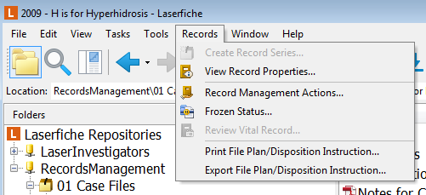
Translating the Scenario
What does this mean to us?
Introduction to managing records
Records menu is your friend
Notes:
The records menu is your friend.

Slide 26

Scenario 2
It’s the beginning of a new year – time to do some cutoff!
Notes:
Since we know that all the cutoff instructions are set up to group records for cutoff at the beginning of the year, that typically means that the new year is a busy time for our records managers. Since we just entered the new year, we have many records which are now eligible for cutoff. Let’s set up a Records Management Search. (Perform cutoff for these records)

Slide 27
Translating the Scenario
What does this mean to us?
Search based on records properties
Perform records management actions at the records folder level
Notes:
Saved searches!

Slide 28

Scenario 3
Time for the annual review of our Contracts for Confidential Investigative Services

Slide 29
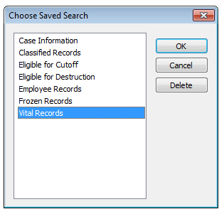
Translating the Scenario
What does this mean to us?
Saved searches make life easier!
Vital records set for periodic review

Slide 30
Scenario 4
Now that records have been reviewed and cutoff, time to check eligibility for disposition
IMPORTANT: The case “Vacation on the Nile” is currently being audited. Make sure it does not get deleted!
Notes:
In our case, we’re simply going to freeze the records in their parent folder, but there are alternative methods to achieve similar results. Audits can be internal, in cases where organizations want to make sure that their records are being managed properly, or audits can be external, where one organization who’s rules must be followed checks in to make sure that the records are managed properly. In cases of an external audit, you may want to restrict the security of the auditors to go only as far as the document that they need access to. But what if there are other records in the folder that you don’t want to give them access to? You can set up a temporary “Auditor” folder where you can drag and drop shortcuts to the relevant documents. Like I said before, for our case, we’ll simply freeze the records in their current folder.

Slide 31

Translating the Scenario
What does this mean to us?
Freeze records to prevent modifications
Automate records management with Workflow

Slide 32

Scenario 5
You’ve found a Contract of Confidential Investigative Services for our client, Funky Expeditions. It wasn’t imported to Laserfiche! Oh dear!
Notes:
Uncutoff the record, import, set filing date, cutoff again

Slide 33
Translating the Scenario
What does this mean to us?
Can uncutoff a record if necessary
Reminder: cannot undelete!
Easy to backdate old records
Notes:
Filing date reflects eligibility for stuff

Slide 34
Scenario 6
The Boss asked for an easy way to view all of a detective’s personnel records in one place. Is this possible while making sure each document follows the correct retention schedule?

Slide 35
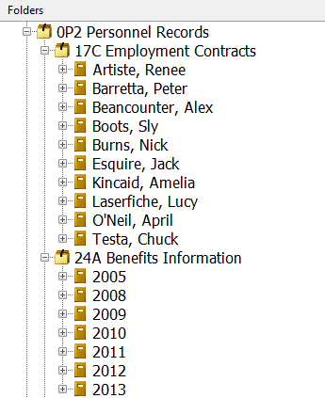
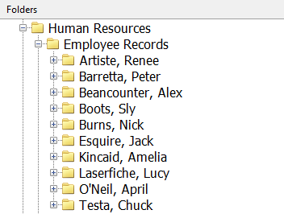
Translating the Scenario
What does this mean to us?
Transparent Records Management

Slide 36
Conclusion
Create records management objects in the Administration Console
And apply those schedules to records folders in the Laserfiche Client
RM actions found in the Records menu
Can search for any records property
Transparent Records Management
Notes:
End your presentation on this slide, but remember to ask for questions.
Resources: List other courses, papers, videos, etc., relevant to your course material.

Slide 37
Resources
Online Help Files:
Records Management Administration
Using Records Management
White Papers:
Transparent Records Management
Notes:
End your presentation on this slide, but remember to ask for questions.
Resources: List other courses, papers, videos, etc., relevant to your course material.

